Slide 1
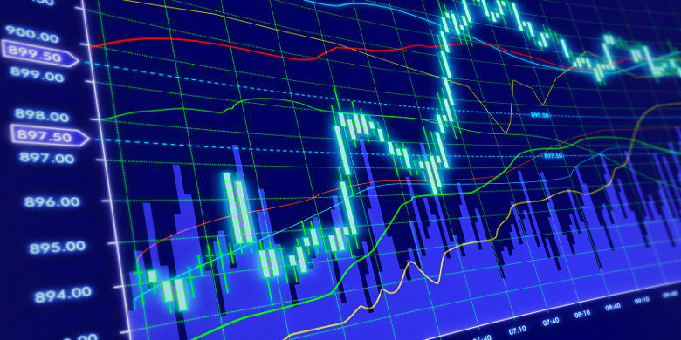
Bounce Back
An analysis of emotional stock volatility to corporate news worthy events
Jan 24, 2018
Names

Slide 2
Executive Summary
Non-statistical sampling suggests equity markets initially overreact to unfavorable corporate news events
These news events can be categorized into:
Product Failure, Service Failure or Fraudulent Practice
Accounting and Financial Misrepresentation
Environmental or Ecological Hazzard
Human Health Hazzard
When the equity price begins losing value, the market becomes more fearful of sustaining further losses and the equity is subsequently sold in a panic
Buying opportunity emerges when the equity becomes undervalued relative to it’s future cash flows

Slide 3
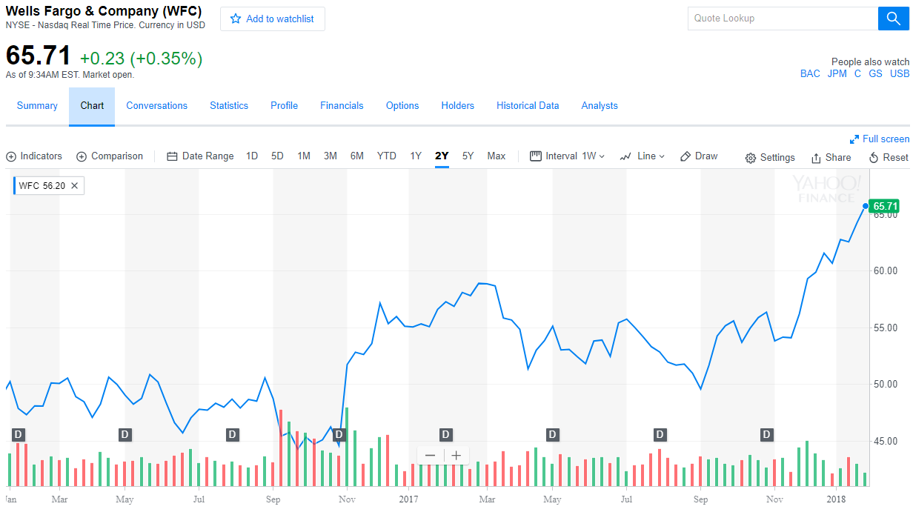
Product Failure, Service Failure or Fraudulent Practice
Wells Fargo: Consumer Financial Protection Bureau and the Los Angeles City Attorney and the Office of the Comptroller of the Currency fine $185 million for opening up over 2 million fake bank and credit card accounts in customers’ names without their knowledge or consent.

Slide 4
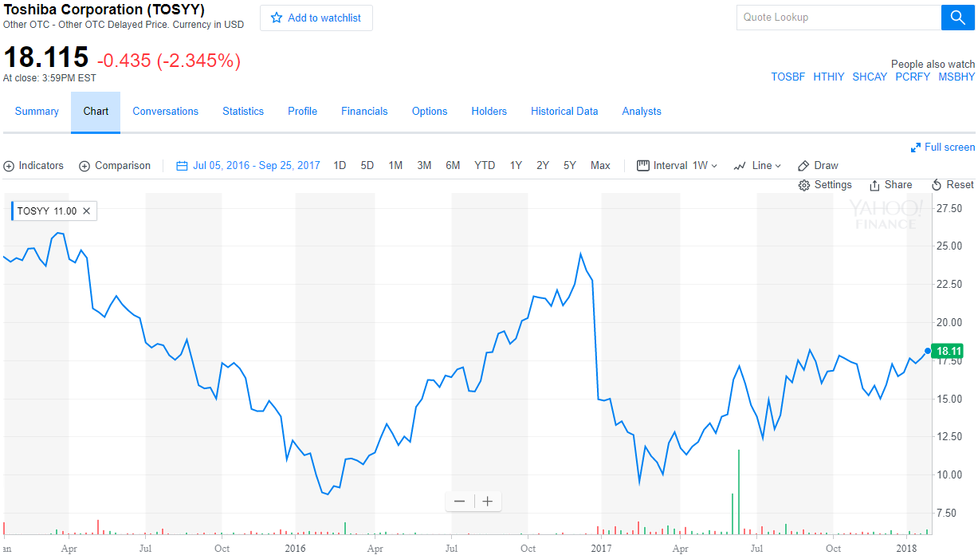
Accounting and Finance Misrepresentation
December 28, 2016 Toshiba’s U.S. nuclear-power subsidiary Westinghouse acquired CB&I Stone & Webster when Toshiba (TOSBF) was still struggling to recover from a $1.2 billion accounting scandal, then warned it is expecting billions of dollars in losses from its takeover

Slide 5
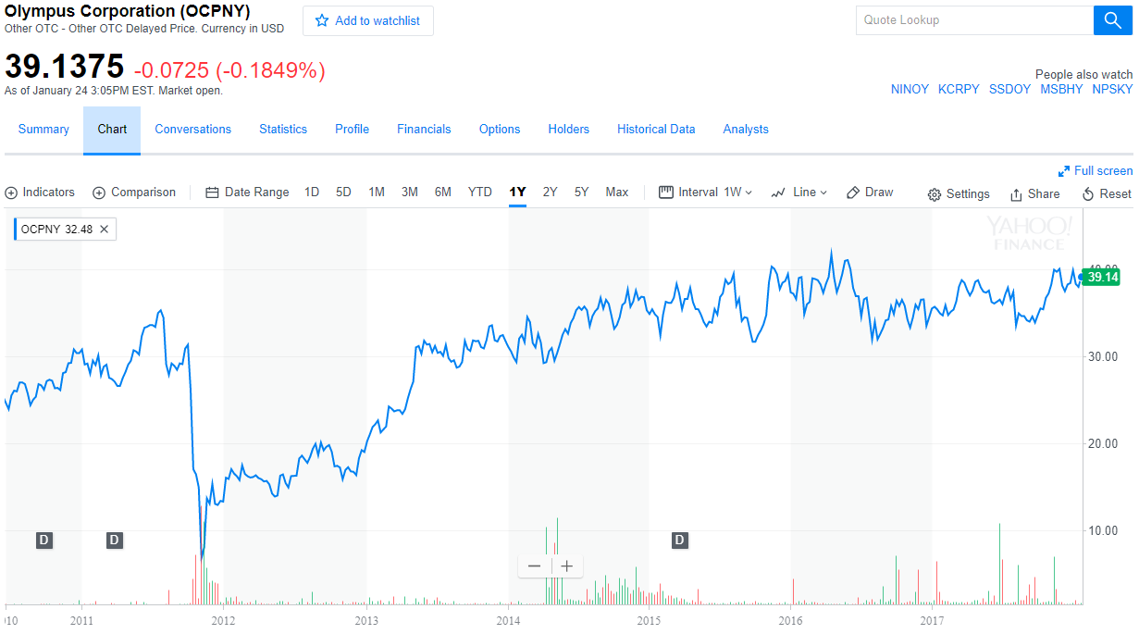
Accounting and Finance Misrepresentation
8 Nov 2011 Olympus admits hiding losses for 20 years. The firm, which has become engulfed by a scandal involving offshore payments that has attracted the attentions of the US Federal Bureau of Investigation, added that it may consider criminal complaints against former executives.

Slide 6
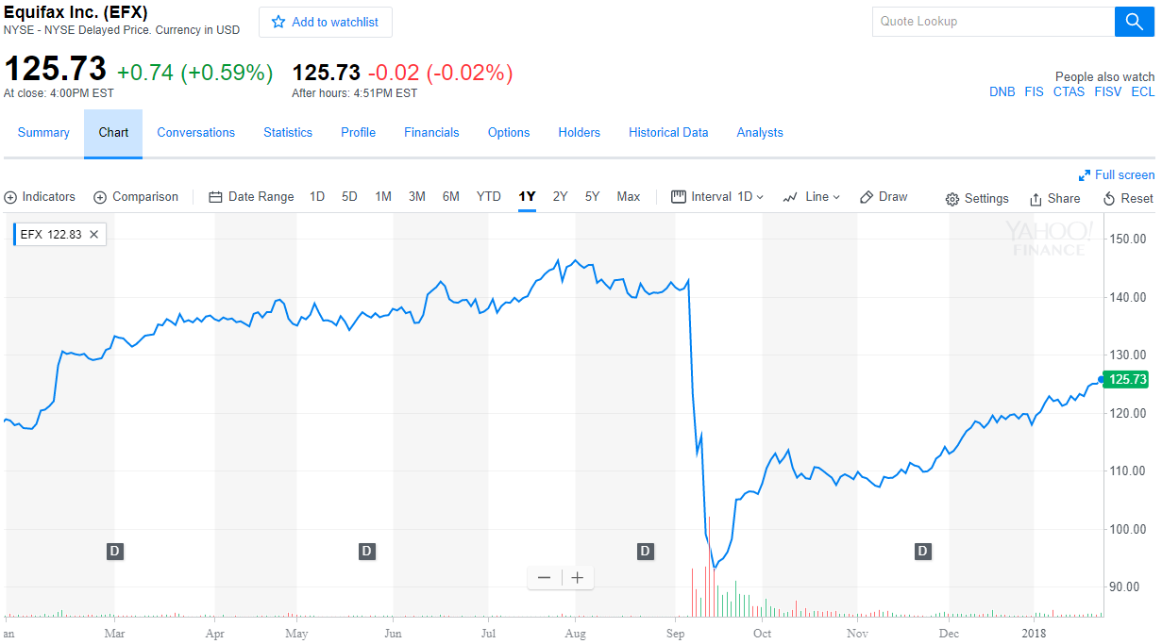
Product Failure, Service Failure or Fraudulent Practice
Credit reporting company Equifax suffered a breach in March, two months before the massive breach that hit as many as 143 million people

Slide 7
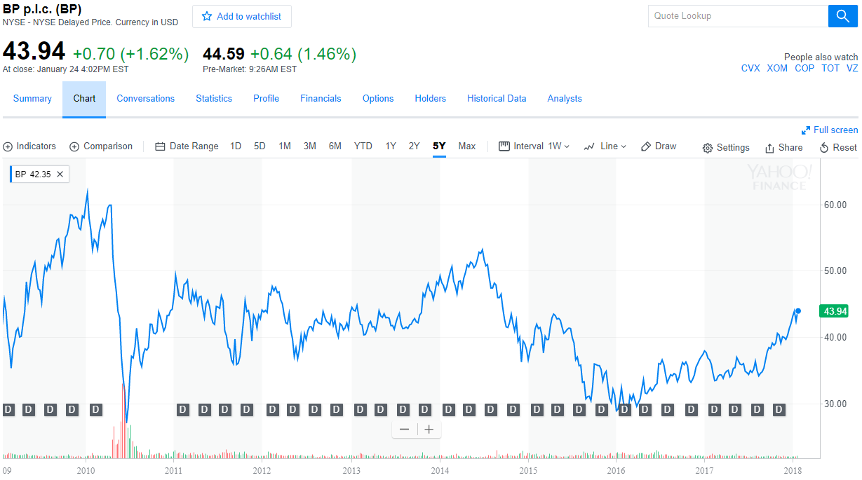
Environmental or Ecological Hazzard
Sep. 18, 2017 Credit reporting company Equifax suffered a breach in March, two months before the massive breach that hit as many as 143 million people

Slide 8
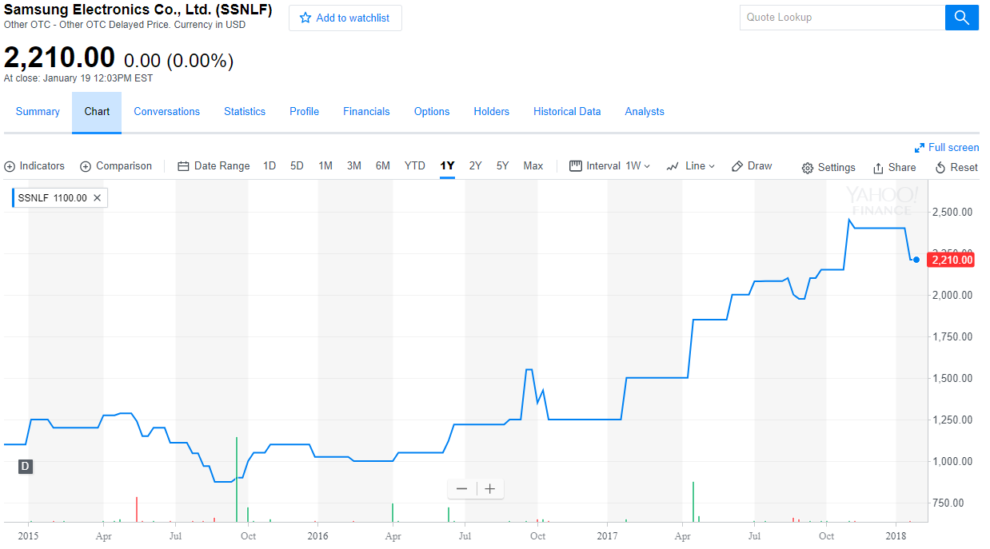
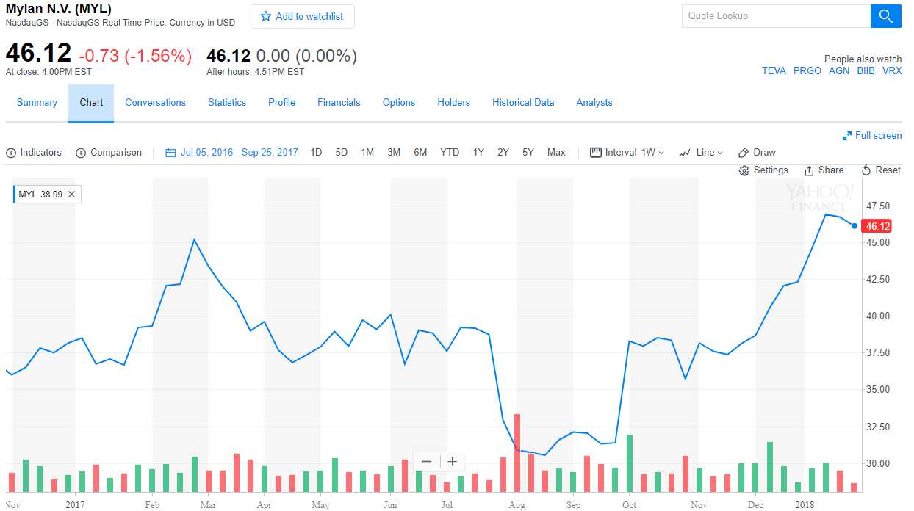
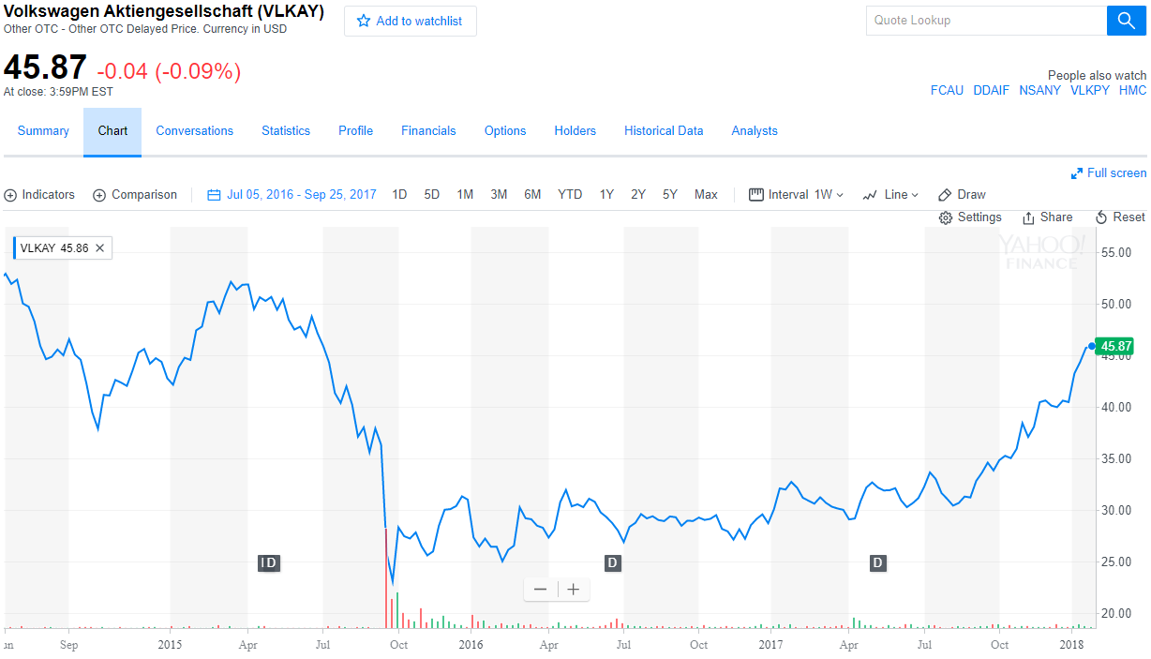
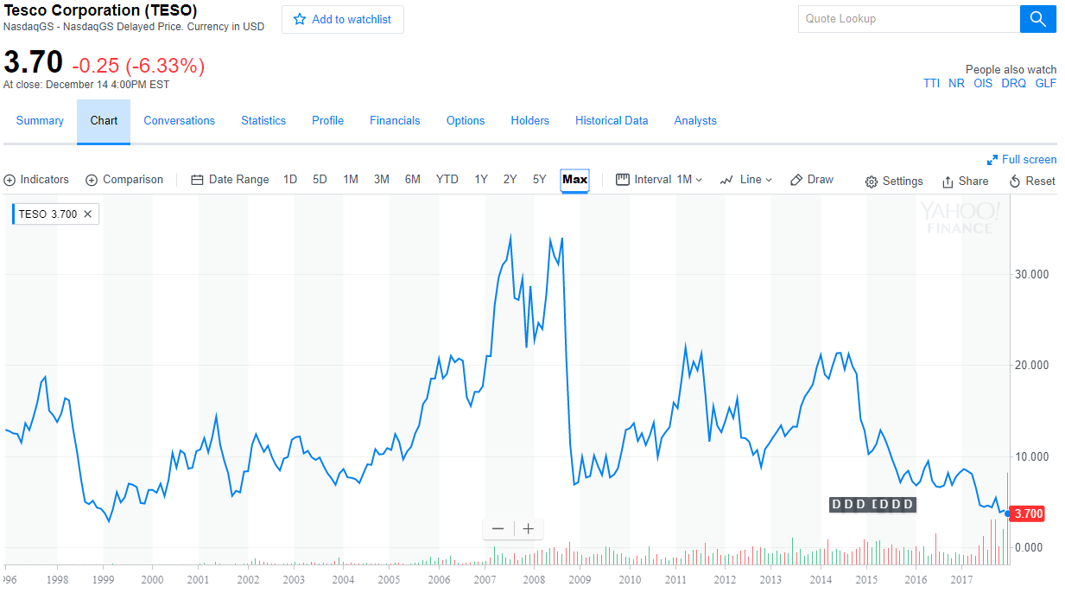
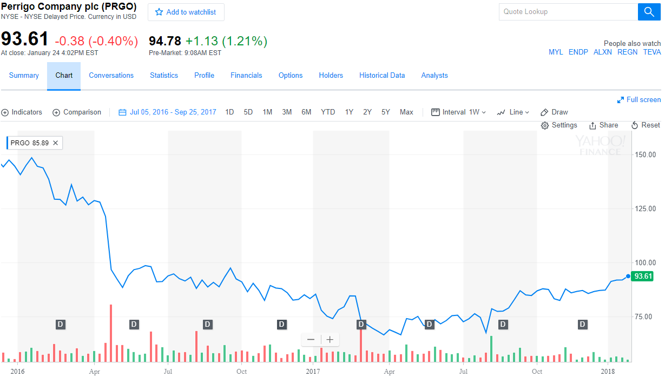
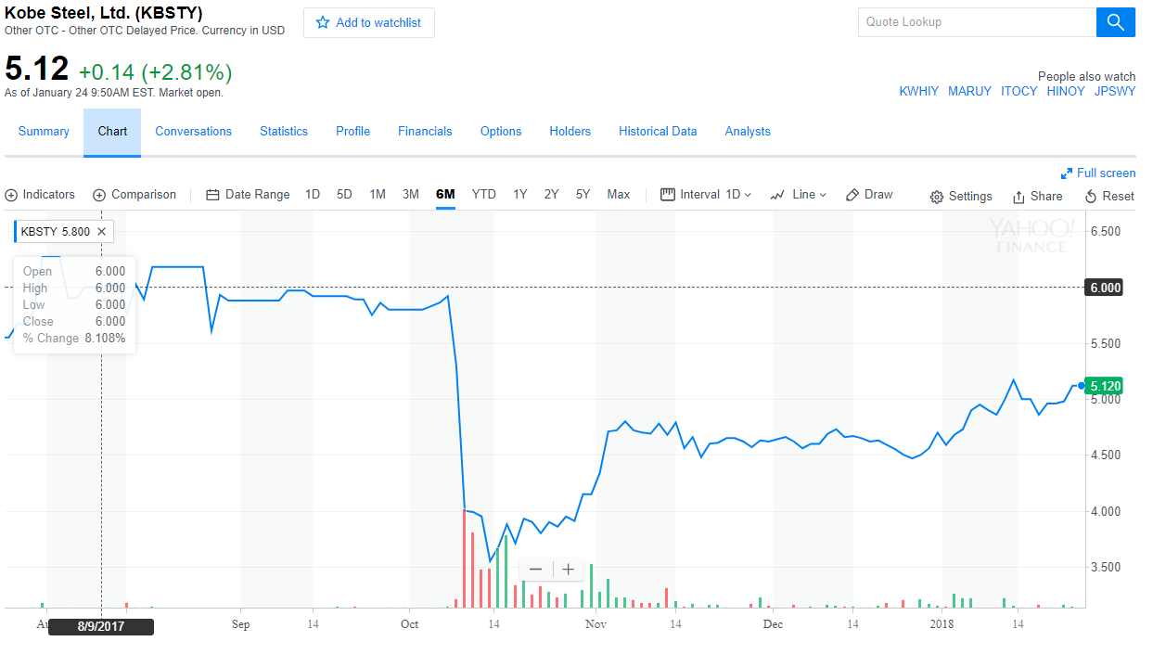
Accounting and Finance Misrepresentation
Samsung Galaxy phones explode
Mylan called to hearing for EpiPen pricing
VW falsifies emissions
Tesco misrepresent financials
??
Kobe Steel misrepresent financials

Slide 9
Methodology

Slide 10
Methodology

Slide 11
Analysis

Slide 12
Findings

